Slide 1
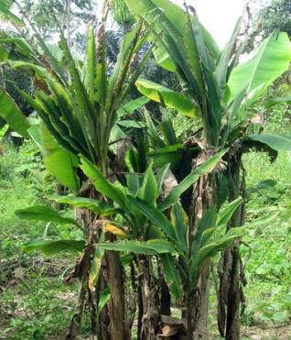
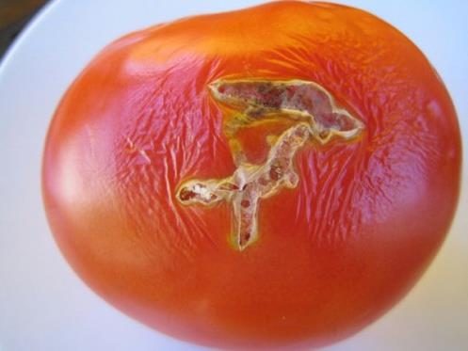
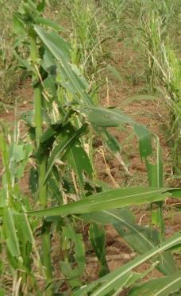
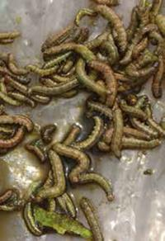
Research and Development Updates on Pests and Diseases
Safeguarding Nigerian Agriculture from Emerging Diseases and Pests
Lava Kumar and Alfred Dixon
International Institute of Tropical Agriculture (IITA)
12 Aug 2016, Presidential Presentation Committee Stakeholders Consultative Workshop Abuja, Nigeria

Slide 2
Outline
Impact of pest and diseases
Recent outbreaks and impending threats
Causes for recurrent outbreaks
Solutions
Recommendations

Slide 3
1. Impact of pest and diseases

Slide 4
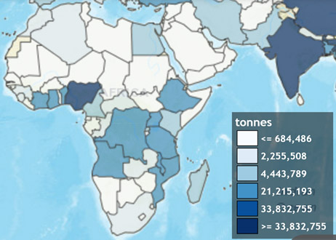
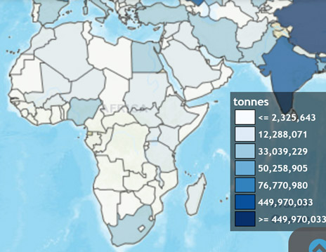
High stakes
Root and tuber crops
Cereal crops
FAO
FAO
Food security is fundamental to peace and prosperity of nations
Annual production of agricultural commodities in Nigeria: 147.82 million tons valued at US$32.5 billion (Source: FAO)
Anecdotal estimates indicates loss of at least 30% production, worth about US$9 billion due to pests and diseases

Slide 5
High stakes
Pests and diseases attack
impede growth
contributes to production decline
constrain value addition
prevent export opportunity due to ‘trade barriers’
Nigeria:
Value-added per capita in agriculture increased by <1% in the past 20 years
An estimated US$10 billion worth of annual exports from groundnut, palm oil, cocoa and cotton lost due to continuous decline in the production and insufficient SPS compliance
(Source: FAO)

Slide 6
2. Recent outbreaks & impending threats

Slide 7
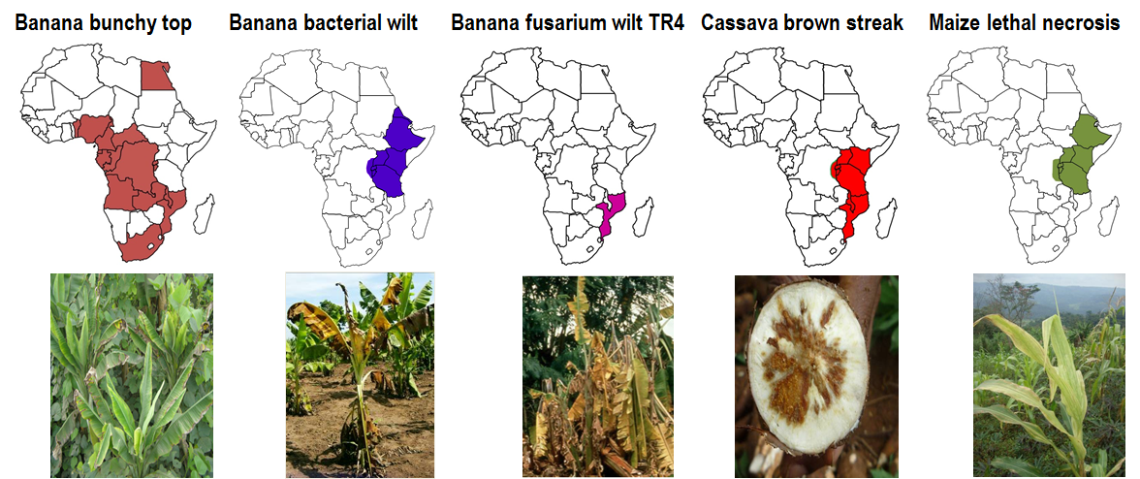
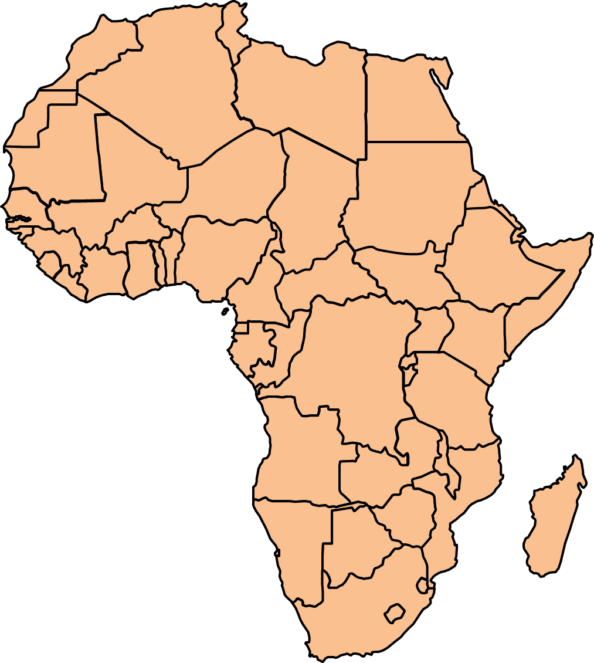
Emerging and Remerging Diseases of 21st Century in Africa
Pan-Africa spread of invasive species
(Occurrence confirmed, suspected or threated countries)
Fall armyworm (Spodoptera frugipreda)
Papaya mealybug (Paracoccus marginatus)
Taro blight (Phytophthora colocasiae)
Tomato leafminer (Tuta absoluta)

Slide 8
High risks to agricultural production
Known threats: endemic pests and diseases
Cassava mosaic, yam mosaic, striga, nematodes
New threats: recent spread; established
Banana bunchy top, papaya mealybug
Emerging threats: New outbreaks
Tuta absoluta, Fall armyworm
Looming threats: high risk of spread into Nigeria
Maize lethal necrosis, Cassava brown streak
Unknown: unanticipated pests or pathogens
?? (Risk prediction)

Slide 9
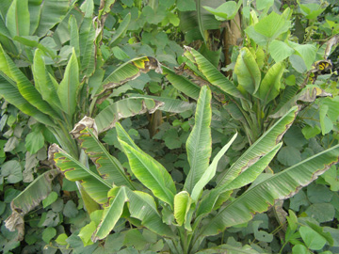

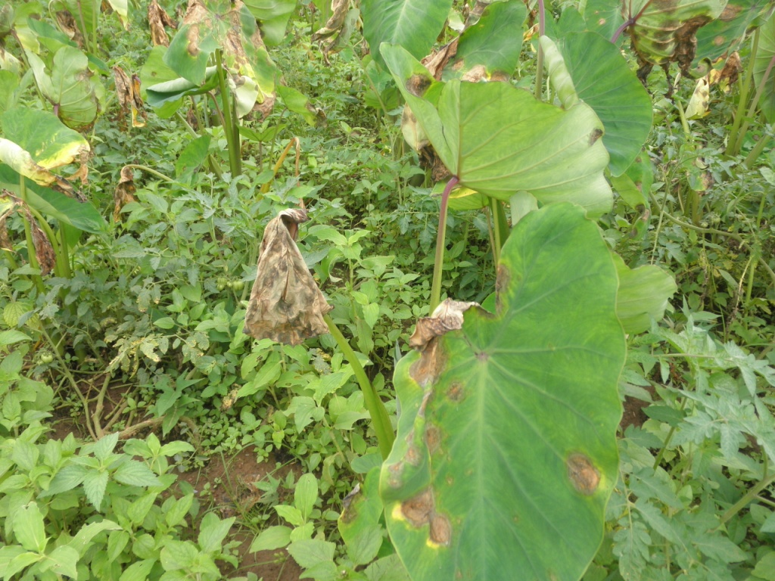
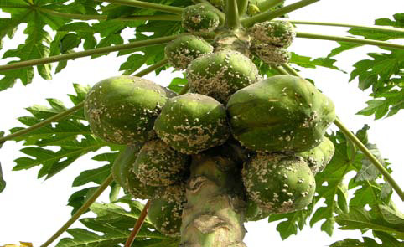

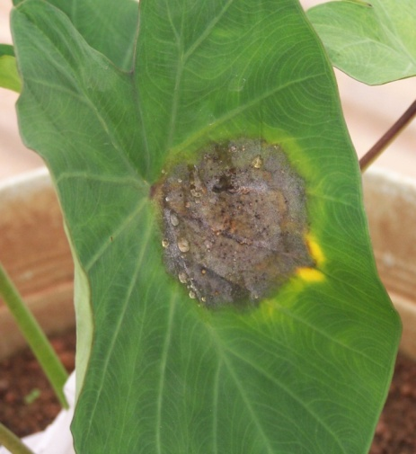
New disease and pest outbreaks
since 2010 in Nigeria
Five major outbreaks caused by newly introduced pests and pathogens
Production and trade losses worth several million US$ and loss of agrobiodiversity
Banana bunchy top
(2012)
Maize army worm
2016
Taro blight
(2010)
Tuta absoluta
2016
Papaya mealybug
2010

Slide 10
3. Causes for recurrent outbreaks

Slide 11
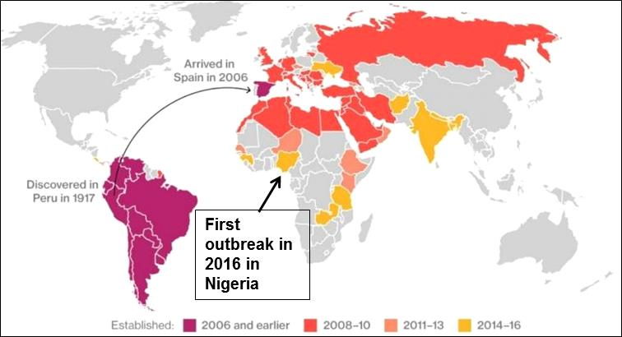
Lack of preparedness
Invasion risk of new pests and pathogens recognized
Poor preparedness
Since 2008, Tuta absoluta spread to 15 countries in Africa
Risk prone countries not equipped with effective pesticides
Crops and farmers left vulnerable to high risk
Source: http://agricnation.com/home/tag/tuta-absoluta/

Slide 12

Some lessons from recent outbreaks
Failed to diagnose problem at early stage due to lack diagnostic tools, appropriate knowledge and control procedures
Major disease outbreaks recognized through media reports
Post-outbreak surveys not organized to assess the extent of spread and damage
Reactive ‘hyper’ response followed by inaction
Poor adoption of procedures and technologies to contain spread
Very little investment to stop epidemics
Not ready to deal with current outbreak or the future epidemics

Slide 13
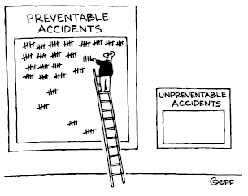

Time for Change
Destructive impact of recent pest outbreaks could have been prevented
Current outbreaks are wake-up call for stern action to protect country’s agriculture

Slide 14
4. Solutions for pest and disease control

Slide 15
Time for Change
Technologies are available,
to stop pest and disease entry into Nigeria
Pre-emptive controls
to prevent disease outbreaks
Emergency response and eradication
limit pest and disease potential to damage crops
Integrated pest and pathogen management
“Can we get ready to prevent next outbreak?”
“There is no excuse not to do right things”
-Bill Gates

Slide 16
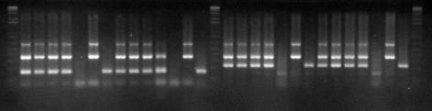
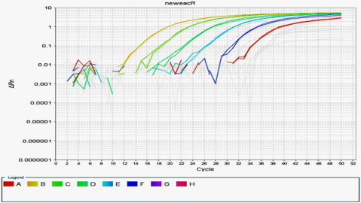
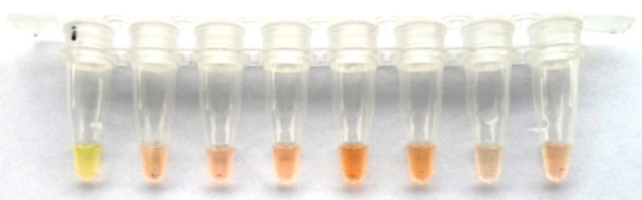
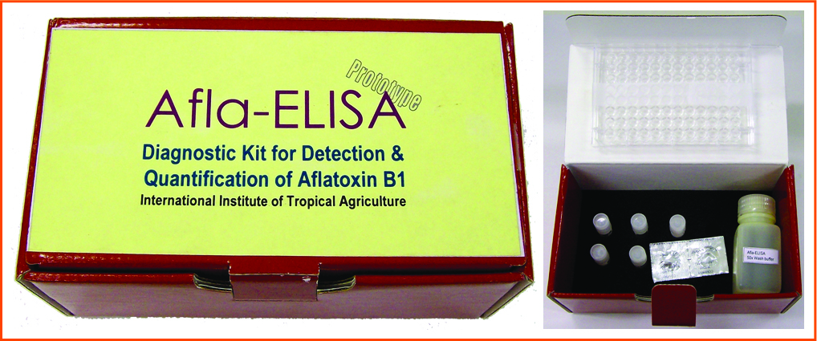
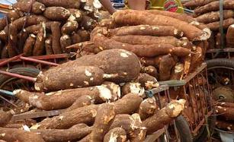
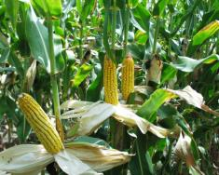
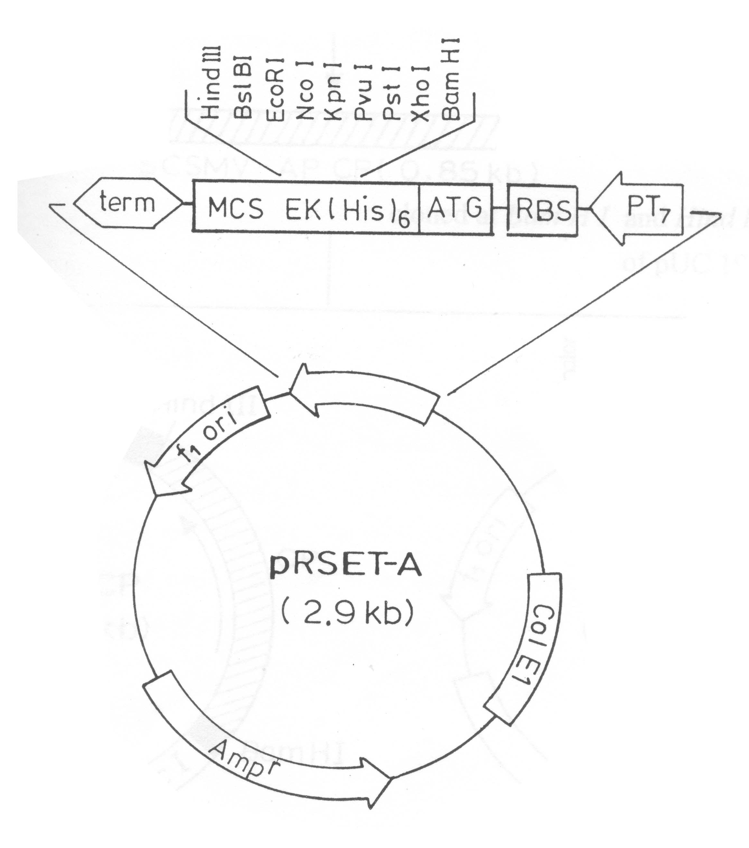
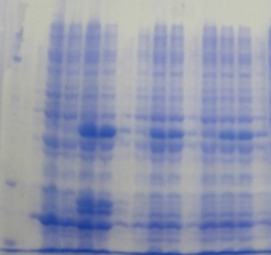
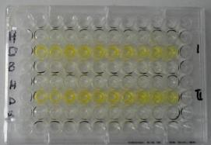
IITA have it all (most of it!)
Discovery
Development
Deployment
IITA in collaboration with the Nigerian national partners developed technologies to diagnose emerging and endemic threats
Technologies and strategies developed for monitoring and deploy emergency response action
Multipronged technologies an strategies developed to prevent/control outbreaks
Extensive outreach is limited by fund availability and lack of enabling environment (weak infrastructure, lack of operational funds and more)

Slide 17
Modus operandi
Prevention: Surveillance, early detection and eradication
Deployment and dissemination of technology
Diagnostic tools (for rapid identification)
Host resistance (Deployment of resistant cultivars)
Integrated management (biocontrol, clean seed systems)
Upscaling of quality seed production technologies
Coordinating action against emerging threats (BBTV, CBSD, MLN, etc)
creation and networking for surveillance
Human resource skill development (training)
Infrastructure upgrade (enabling capacity)
Notes:
All these approaches are being used to prevent spread of diseases into West Africa. Only given three examples as cases all of which covers recent progress.
-Alliance approach to control BBTV in SSA.
-Improving diagnostics
-Pre-emptive breeding
-Training and capacity development

Slide 18
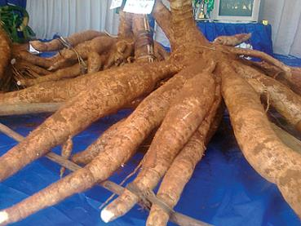
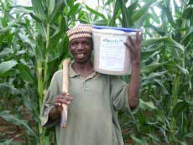
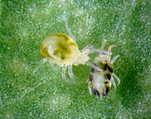
Lasting solutions
Resistant varieties:
Offer sustainable protection against pest and diseases
Highly resistant varieties available for some diseases (e.g. CMD) but not all.
IITA and partners released several improved disease resistant varieties
Pre-emptive breeding in East Africa for CBSD and MLN
Biological control :
Offer sustainable protection against insect pests
IITA has released several biocontrol agents, (mealybug control, ‘aflasafe’, etc.)
On-going R&D to find solutions to several pests & diseases

Slide 19
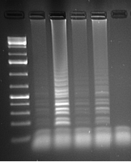
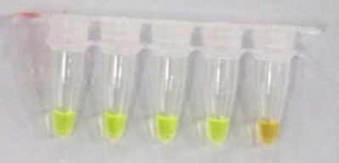
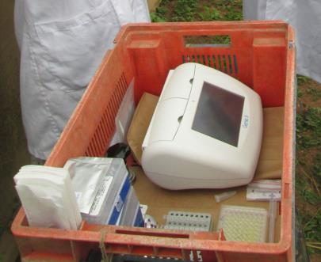
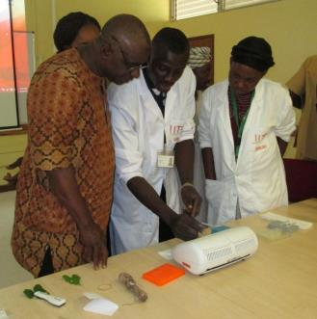
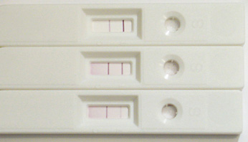
Range of Diagnostics Tools For lab and field applications
LAMP
New diagnostics for emerging and established threats
Conventional PCR and ELISA-Methods for over 60 pests and pathogens available
Quick diagnostics for field monitoring, quarantine surveillance and seed certification
Loop-mediated isothermal amplification (LAMP):
Recombinase polymerase amplification (RPA):
Lateral flow diagnostics (LFD)
Easy sample preparation; results within 10 to 30 min.
DNA barcoding
+ + + + -
+ + + + -
LFD
YMV QuickChip
RPA
©www.bioassayworks.com
Materials for off-lab work
Off-lab demo

Slide 20
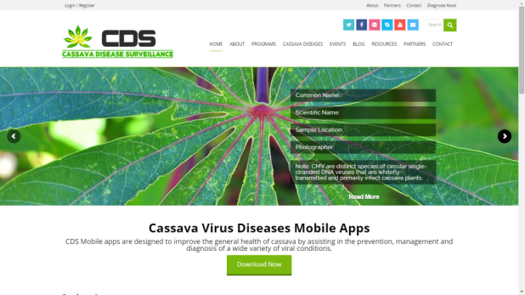
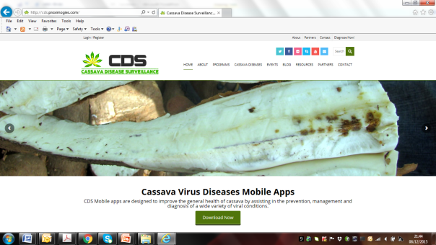
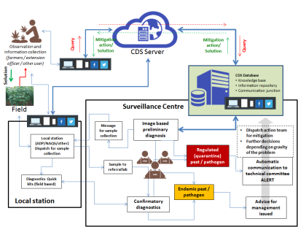
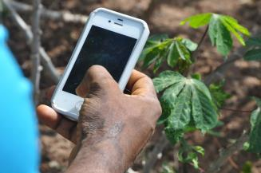
ICT Technologies
Digital surveillance for real time monitoring essential to prevent future outbreaks
‘smart’ solutions through mobile phones
Communication
Coordination
Conveying solutions
Emergency alert
Rapid response
www.cassavadiseasenet.org

Slide 21

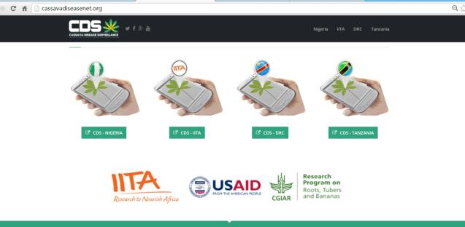
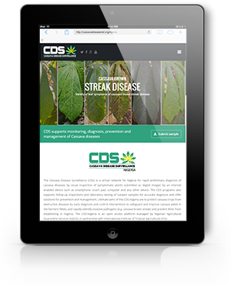
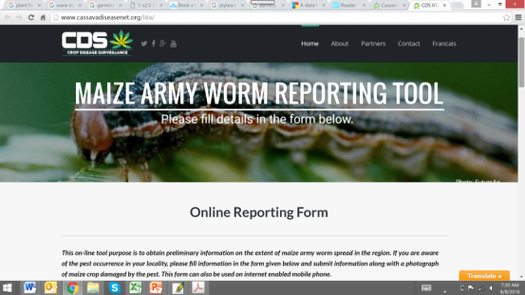

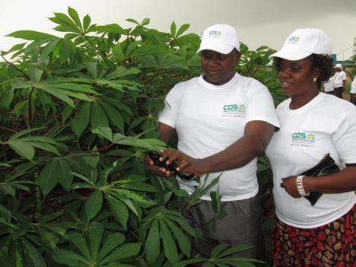
Digital Diagnostics Platform
Real time surveillance and emergency response
Web-App usable on smart phones and internet-enabled devices (image-based diagnosis and lab confirmation)
Enable rapid communication and diagnosis
Coordinated surveillance network and response
Cassava disease surveillance (www.cassavadiseasenet.org)
Piloted in Nigeria by NAQS
CDS application by NAQS staff

Slide 22
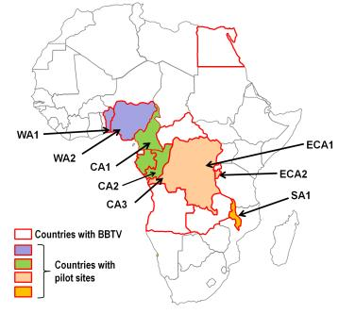
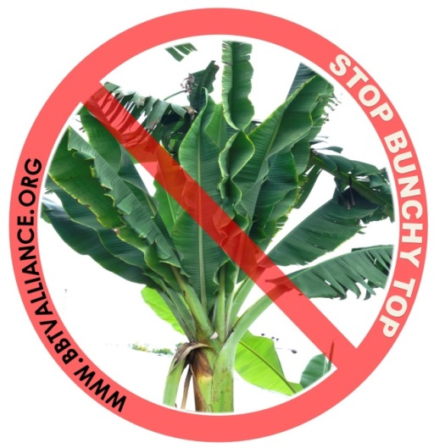

Alliance approach for BBTD control in Africa
Coordinated continental action plan
www.bbtvalliance.org
Common framework in the BBTV-affected countries for “containment” of virus spread, “eradication” of infected plants and “Recovery” of banana Production
Capacity development, Awareness Raising and Advocacy
Benin, Burundi, Cameroon, Congo Brazzaville, DR Congo, Gabon, Malawi and Nigeria
Similar consortia for controlling Maize Lethal Necrosis and Cassava Brown Streak

Slide 23
5. Recommendations
Develop a ‘National Agricultural Biosecurity Strategy’ for preparedness to cope with emerging pest and pathogen risks to Nigerian agriculture
Adopt available procedures and technologies for pest and disease control
Create a platform for Government-Industry-Research interactions for advocacy, knowledge & technology sharing, dialogue and planning
Strengthen Nigerian Agricultural Quarantine Services (NAQS) and other regulatory bodies to enable active surveillance
Train staff and improve infrastructure to support rapid surveillance and pest and disease diagnostics
Adopt digital technologies for surveillance, monitoring and emergency response action
Develop a long term investment plan and allocate budget for improvements

Slide 24
Agricultural prosperity depends on strong ‘political will’ and our collective actions
Thanks for your attention
Contact
Lava Kumar (L.kumar@cgiar.org)
Alfred Dixon (a.dixon@cgiar.org)
IITA is funded by the CGIAR and several donors, including Africa Development Bank, BMGF, DFID, EU, USAID and several government organizations

